Slide 1
Programming Logic and Design Seventh Edition
Chapter 2
Elements of High-Quality Programs
Online Tutorial compiler:
https://www.tutorialspoint.com/compile_c_online.php

Slide 2
Objectives
In this chapter, you will learn about:
Declaring and using variables and constants
Performing arithmetic operations
The advantages of modularization
Modularizing a program
Hierarchy charts
Features of good program design

Slide 3
Declaring and Using Variables and Constants
Data types
Numeric consists of numbers
String is anything not used in math
Different forms
Integers and floating-point numbers
Literal and string constants
Unnamed constants الثوابت غير المسماة

Slide 4
Working with Variables
Variables Named memory locations, the contents of which can vary or differ over time.
Declaration
Statement that provides a data type and an identifier for a variable. One type of the variable declaration is
var X var Y
Identifier
Variable’s name

Slide 5
Working with Variables (continued)
Data type - Classification that describes:
What values can be held by the item
How the item is stored in computer memory
What operations can be performed on the data item
Initializing the variableتهيئة المتغيرات
Declare a starting value for any variable
Assigning value to a variable after declaring
X = 100 Y = 200
we can implement the two operations together: var X = 100
Garbageمخلفات
Variable’s unknown value before initialization

Slide 6
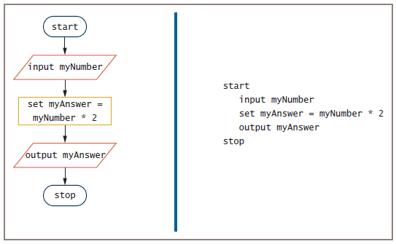
Working with Variables (continued)
Figure 2-1 Flowchart and pseudocode for the number-doubling program

Slide 7
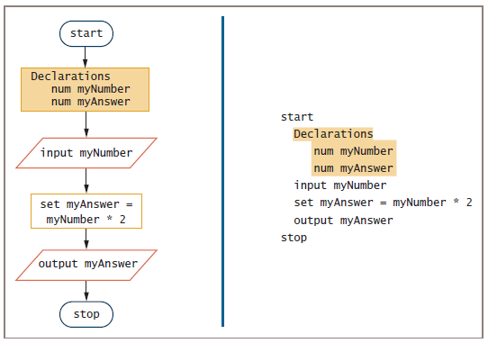
Figure 2-2 Flowchart and pseudocode of number-doubling
program with variable declarations

Slide 8
Naming Variables
Programmer chooses reasonable and descriptive names for variables
Programming languages have rules for creating identifiers
Most languages allow letters and digits starts with a letter or underscore ‘_’
Some languages allow hyphens ‘-’
Reserved keywords are not allowed
Variable names are case sensitive
Camel casing
Variable names such as hourlyWage have a “hump” in the middle
Be descriptive
Must be one word
Must start with a letter
Should have some appropriate meaning

Slide 9
Assigning Values to Variables
Assignment statement
set myAnswer = myNumber * 2
Assignment operator
Equal sign
Always operates from right to left
Valid
set someNumber = 2
set someOtherNumber = someNumber
Not valid
set 2 + 4 = someNumber

Slide 10
Understanding the Data Types of Variables
Numeric variable
Holds digits
Can perform mathematical operations on it
String variable
Can hold text
Letters of the alphabet
Special characters such as punctuation marks
Type-safety
Prevents assigning values of an incorrect data type

Slide 11
Declaring Named Constants
Named constant
Similar to a variable
Can be assigned a value only once
Assign a useful name to a value that will never be changed during a program’s execution
Magic number
Unnamed constant
Use taxAmount = price * SALES_TAX_AMOUNT instead of taxAmount = price * .06

Slide 12
Performing Arithmetic Operations
Standard arithmetic operators:
+ (plus sign)—addition
− (minus sign)—subtraction
* (asterisk)—multiplication
/ (slash)—division

Slide 13
Performing Arithmetic Operations (continued)
Rules of precedence
Also called the order of operations
Dictate the order in which operations in the same statement are carried out
Expressions within parentheses are evaluated first
Multiplication and division are evaluated next
From left to right
Addition and subtraction are evaluated next
From left to right

Slide 14
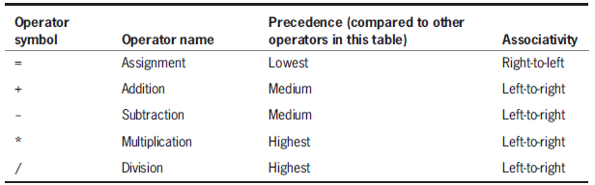
Performing Arithmetic Operations (continued)
Left-to-right associativity
Operations with the same precedence take place from left to right
Table 2-1 Precedence and associativity of five common operators

Slide 15
Performing Arithmetic Operations (continued)
Addition or Multiplication C Program: Only by changing “+” with “*”
Examples:
#include <stdio.h>
int main()
{
int x, y, z;
x = 6;
y = 8;
z = x * y;
printf("%d * %d = %d", x, y, z);
return 0;
}

Slide 16
main() Function- Variations
The main() function groups activities and can take in parameters (information) and pass back values (again, information).
main() is a function, which is invoked (called) through operating system when program's execution is going to start.
main() function is unique from other functions, because the values it returns are returned to the operating system.
Other functions that you will use and create return values back to the calling C statement inside the main() function.
There are some variations of main() function:
void main(void);
void main();
int main(void);
int main();
int main(int argc, char argv);
int main(int argc, char argv[]);
argc is the number of argument passing in main() function,
argv is the pointer to strings
Some compilers may not support void as return type of main() function.
void indicates that no value is available.

Slide 17
return 0 Function
It is not necessary that every time you should use return 0 to return program's execution status from the main() function.
But returned value indicates program's success or failure to the operating system and there is only one value that is:
return 0 which can indicate success
non zero values (for example: return 1) can indicate failure of execution due to many reasons.
If fails due to lake of memory we can return -1,
if fails due to file opening we can return -2,
if it fails due to any invalid input value we can return -3 and so on.
If program's execution is success we should return 0.
#include <stdio.h>
#include <stdlib.h>
int main()
{ printf("Hello, World!\n");
return EXIT_SUCCESS;
}
Output: Hello, World!

Slide 18
return 0 Function – (continued)
#include <stdio.h>
int main()
{
FILE *fp; //open any file
fp=fopen("sample.txt","r");
if(fp==NULL)
{
printf("Error in file opening!!!\n");
return -1; }
printf("File opened successfully.\n"); //closing the file
fclose(fp);
return 0;
}
Output: Error in file opening!!!
Since we don't have this file "sample.txt", program will print "Error in file opening!!!" and return -1 to the operating system.

Slide 19
Program to Print an Integer
#include <stdio.h>
int main()
{
int number;
// printf() dislpays the formatted output
printf("Enter an integer: ");
// scanf() reads the formatted input and stores them
scanf("%d", &number);
// printf() displays the formatted output
printf("You entered: %d", number);
return 0;
}
Output: Enter a integer: 35
You entered: 35
In a C program, the semicolon is a statement terminator. Each statement must be ended with a semicolon.

Slide 20
Performing Arithmetic Operations (continued)
Example:
#include <stdio.h>
Int main()
{
int x = 1;
int y = 2;
x = y * x + 1; //arithmetic operations performed before assignment
printf("\n The value of x is: %d\n", x);
x = 1;
y = 2;
x += y * x + 1; //arithmetic operations performed before assignment
printf("The value of x is: %d\n", x);
} //end main function
The program above outputs the following text.
The value of x is: 3
The value of x is: 4

Slide 21
Understanding the Advantages of Modularization
Modules
Subunit of programming problem
Also called subroutines, procedures, functions, or methods
Modularization
Breaking down a large program into modules
Reasons
Abstraction
Allows multiple programmers to work on a problem
Reuse your work more easily

Slide 22
1-Modularization Provides Abstraction
Abstraction
Paying attention to important properties while ignoring nonessential details
Selective ignorance
Newer high-level programming languages
Use English-like vocabulary
One broad statement corresponds to dozens of machine instructions
Modules provide another way to achieve abstraction

Slide 23
2-Modularization Allows Multiple Programmers to Work on a Problem
Easier to divide the task among various people
Rarely does a single programmer write a commercial program
Professional software developers can write new programs quickly by dividing large programs into modules
Assign each module to an individual programmer or team

Slide 24
3-Modularization Allows You to Reuse Work
Reusability
Feature of modular programs
Allows individual modules to be used in a variety of applications
Many real-world examples of reusability
Reliability
Assures that a module has been tested and proven to function correctly

Slide 25
Modularizing a Program
Main program
Basic steps (mainline logic) of the program
Include in a module
Module header
Module body
Module return statement
Naming a module
Similar to naming a variable
Module names are followed by a set of parentheses

Slide 26
Modularizing a Program (continued)
When a main program wants to use a module
“Calls” the module’s name
Flowchart
Symbol used to call a module is a rectangle with a bar across the top
Place the name of the module you are calling inside the rectangle
Draw each module separately with its own sentinel symbols

Slide 27
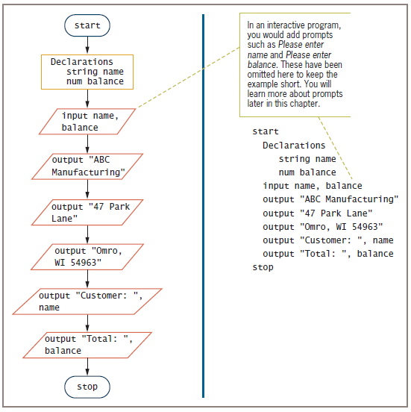
Figure 2-3 Program that produces a bill using only main program

Slide 28
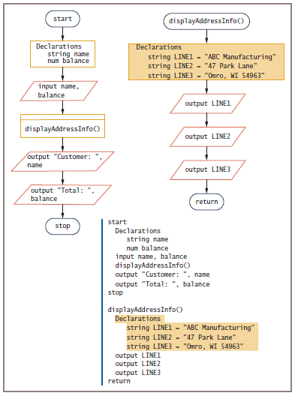
Figure 2-5 The billing program with constants declared within the module

Slide 29
Modularizing a Program (continued)
Statements taken out of a main program and put into a module have been encapsulated
Main program becomes shorter and easier to understand
Modules are reusable
When statements contribute to the same job, we get greater functional cohesion

Slide 30
Declaring Variables and Constants within Modules
Place any statements within modules
Input, processing, and output statements
Variable and constant declarations
Variables and constants declared in a module are usable only within the module
Visible
In scope, also called local
Portable
Self-contained units that are easily transported

Slide 31
Declaring Variables and Constants within Modules (continued)
Global variables and constants
Declared at the program level
Visible to and usable in all the modules called by the program
Many programmers avoid global variables to minimize errors

Slide 32
Understanding the Most Common Configuration for Mainline Logic
Mainline logic of almost every procedural computer program follows a general structure
Declarations for global variables and constants
Housekeeping tasks
Detail loop tasks
End-of-job tasks

Slide 33
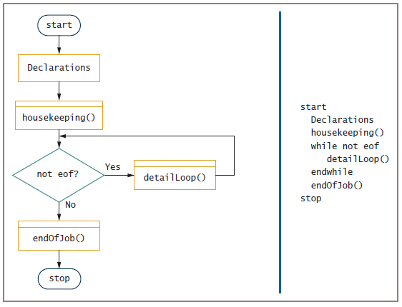
Understanding the Most Common Configuration for Mainline Logic (cont’d)
Figure 2-6 Flowchart and pseudocode of mainline logic for a typical procedural program

Slide 34
Creating Hierarchy Charts
Hierarchy chart
Shows the overall picture of how modules are related to one another
Tells you which modules exist within a program and which modules call others
Specific module may be called from several locations within a program
Planning tool
Develop the overall relationship of program modules before you write them
Documentation tool

Slide 35
Features of Good Program Design
Use program comments where appropriate
Identifiers should be chosen carefully
Strive to design clear statements within your programs and modules
Write clear prompts and echo input
Continue to maintain good programming habits as you develop your programming skills

Slide 36
Using Program Comments
Program comments
Written explanations of programming statements
Not part of the program logic
Serve as documentation for readers of the program
Syntax used differs among programming languages
Flowchart
Use an annotation symbol to hold information that expands on what is stored within another flowchart symbol

Slide 37
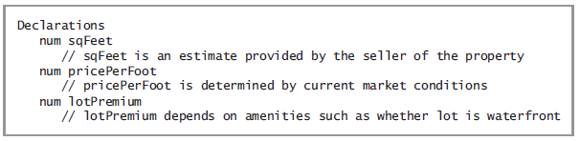
Using Program Comments (continued)
Figure 2-12 Pseudocode that declares some variables and includes comments

Slide 38
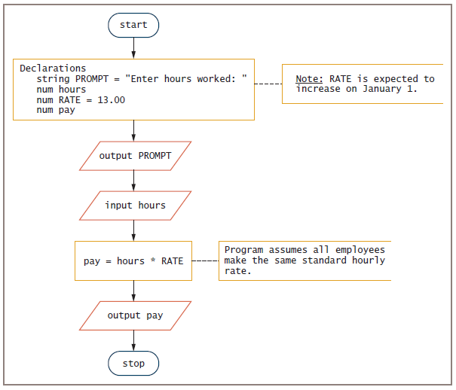
Figure 2-13 Flowchart that includes annotation symbols

Slide 39
Choosing Identifiers
General guidelines
Give a variable or a constant a name that is a noun (because it represents a thing)
Give a module an identifier that is a verb (because it performs an action)
Use meaningful names
Self-documenting
Use pronounceable names
Be judicious in your use of abbreviations
Avoid digits in a name
Notes:
استخدم اسماء لها معنى
استخدم اسماء لفظية
كن حكيما في اختيار الاختصارات

Slide 40
Choosing Identifiers (continued)
General guidelines (continued)
Use the system your language allows to separate words in long, multiword variable names.
Consider including a form of the verb to be
Name constants using all uppercase letters separated by underscores (_)
Programmers create a list of all variables
Data dictionary

Slide 41
Designing Clear Statements
Avoid confusing line breaks
Use temporary variables to clarify long statements

Slide 42
Avoiding Confusing Line Breaks
Most modern programming languages are free-form
Make sure your meaning is clear
Do not combine multiple statements on one line

Slide 43
Using Temporary Variables to Clarify Long Statements
Temporary variable
Work variable
Not used for input or output
Working variable that you use during a program’s execution
Consider using a series of temporary variables to hold intermediate results

Slide 44
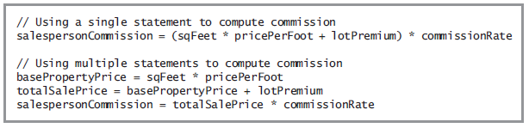
Using Temporary Variables to Clarify Long Statements (continued)
Figure 2-14 Two ways of achieving the same salespersonCommission result

Slide 45
Writing Clear Prompts and Echoing Input
Prompt
Message displayed on a monitor to ask the user for a response
Used both in command-line and GUI interactive programs
Echoing input
Repeating input back to a user either in a subsequent prompt or in output

Slide 46
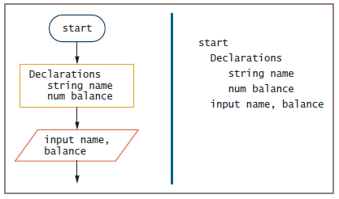
Writing Clear Prompts and Echoing Input (continued)
Figure 2-15 Beginning of a program
that accepts a name and balance as input

Slide 47
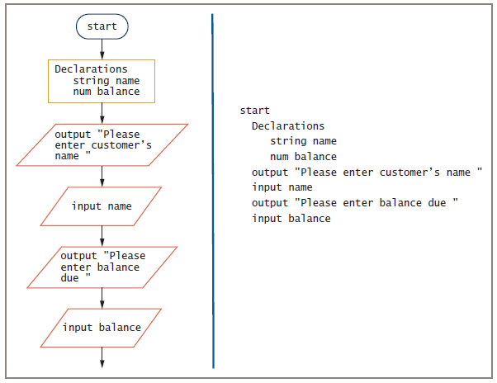
Figure 2-16 Beginning of a program that accepts a
name and balance as input and uses a separate prompt for each item

Slide 48
Maintaining Good Programming Habits
Every program you write will be better if you:
Plan before you code
Maintain the habit of first drawing flowcharts or writing pseudocode
Desk-check your program logic on paper
Think carefully about the variable and module names you use
Design your program statements to be easy to read and use

Slide 49
Summary
Programs contain literals, variables, and named constants
Arithmetic follows rules of precedence
Break down programming problems into modules
Include a header, a body, and a return statement
Hierarchy charts show relationship among modules
As programs become more complicated:
Need for good planning and design increases

Slide 50
